Slide 1


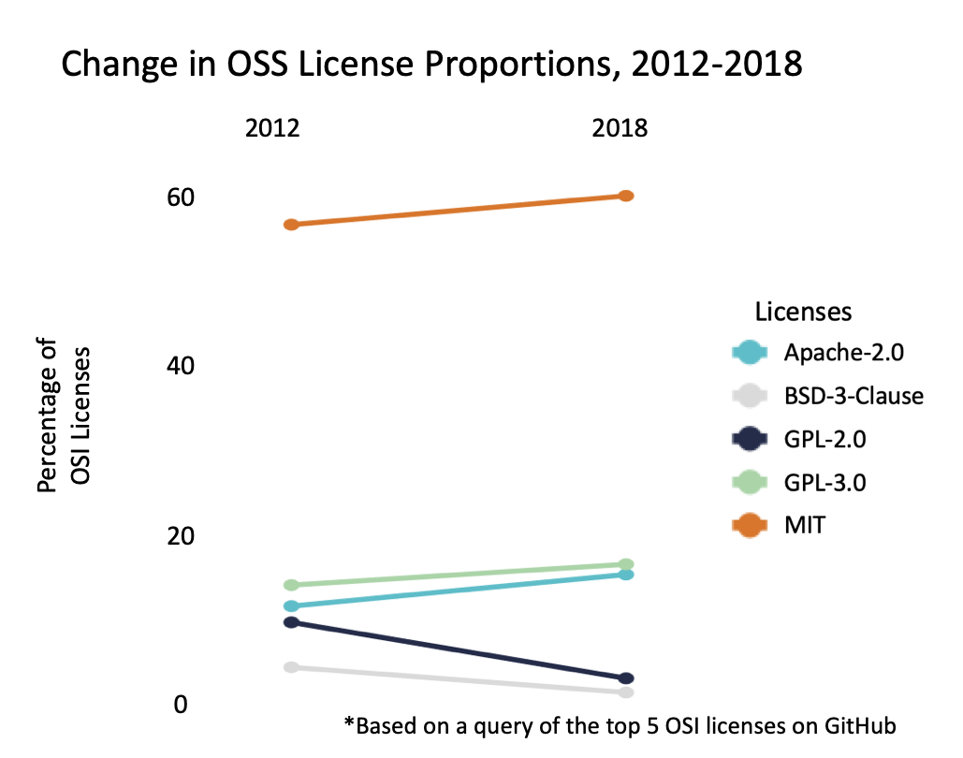
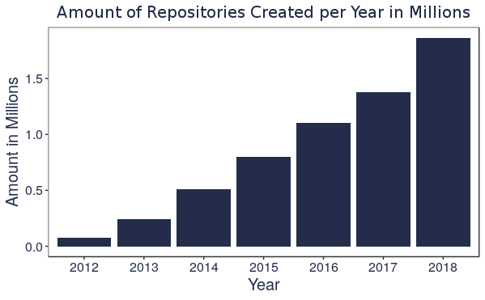
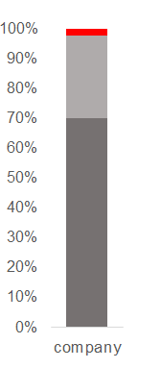
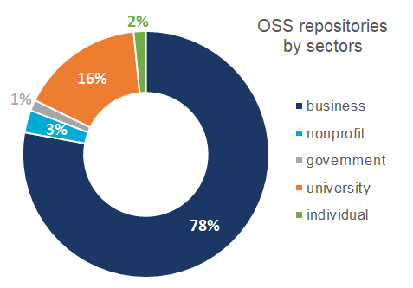
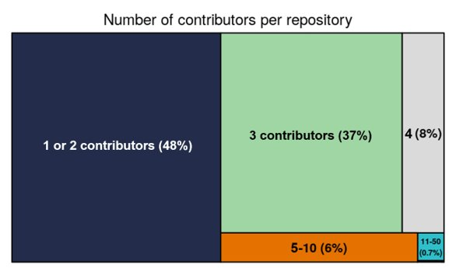

MEASURING THE UNIVERSE OF
OPEN SOURCE SOFTWARE
DSPG Team: Cong Cong (Illinois), Calvin Isch (Indiana University), and Eliza Tobin​ (University of Virginia)
SDAD Team: Gizem Korkmaz, Bayoán Santiago Calderón, Brandon Kramer, and Aaron Schroeder
Sponsor: Carol Robbins, The National Center for Science & Engineering Statistics (NCSES) at the National Science Foundation (NSF)
Project Introduction
Terminology
This project aims to measure how much Open Source Software (OSS) exists and to better understand the distribution of OSS creation across various sectors to evaluate the economic impact of OSS.
Traditional measures of innovation (copyrights, patents, and trademarks) do not accurately capture the universe of OSS innovation.
We define the OSS universe as all GitHub repositories with a registered OSI-approved license.
Open Source Initiative (OSI) – a worldwide non-profit that spreads knowledge about OSS, promotes its usage, and connects various OSS communities [1].
Open Source Software (OSS) – a computer software, with its source code made available with a license, in which the copyright holder provides the rights to study, change, and distribute the software to anyone and for any purpose (Source: OSI).
OSS Licenses – define limitations of use and provide developers with rights over their work while promoting the dispersion of free, accessible code. OSS licenses allow software to be freely used, modified and shared.
Data Collection
We used multiple sources to access information on GitHub repositories:
                GHTorrent – an online, up-to-date database of GitHub initially funded by TUDelft & Microsoft [2]
                GraphQL – GitHubs current API system includes repository names, owners, and license information [3]
Repository creation date
Contributor name
Self-reported location
Self-reported company
Commits
License
GitHub - world's largest website for developers to build and share software (github.com)
Repository (Repo) - contains all of a project's files and relevant discussions
Commit - an individual change to a file for a repository
Contributor - someone who successfully committed to a project
Slug - URL friendly combination of owner and repo name (i.e., Nosferican/Econometrics.jl)
GHTorrent
Slug
(owner/repo name)
We collected
55.1M repositories with commits from GHTorrent between 2012-2018,
7M repositories with OSI-approved licenses on GitHub as of July 2019.
Of those, we analyzed 4.9M repos that have at least one commit.
GraphQL
Data Analysis
Licenses
Although 87 OSI-approved licenses exist, the top 13 licenses contain >99% of OSS repos on GitHub.
The most popular ones are:
  MIT: Massachusetts Institute of Technology
  Apache License
  GPL: GNU Public License
  BSD: Berkeley Software Distribution
MIT, GPL-3.0 and Apache have been increasing in proportion. These licenses are generally more permissive.
GPL-2.0 and BSD, two more restrictive licenses, decreased in proportion.
License regulations vary:
  MIT license allows developers to use the code for any purpose.
  The GPL license grants the ability to use the respective code under the stipulation that derivative work remains open source.
MIT is the most common OSS license (55%). These five licenses (presented above) together comprise about 93% of all OSS on GitHub.
OSS Projects and Contributors
Limitations: Sectors
The number of GitHub repos with an OSS license has been increasing. In 2012 there were 79.4K repos open source licenses. By 2018, there were 1.9M.
We can only identify ~2% of the users’ sectors
We use the self-reported company field in contributors profile.
Only 2% of the contributors
can be identified.
OSS is becoming more permissive as businesses contribute more code.
Unidentified
Missing Value
There are 2.8M unique OSS contributors
On average one repository receives 36.5 commits
Most repositories have fewer than 5 contributors.
On average, 1.94 contributors work on each OSS repository.
Only 0.3% of all OSS repositories have more than 50 contributors.
Conclusions
OSS is growing rapidly; 2,350% increase from 2012 to 2018
Permissive licenses are becoming more common (MIT is the most popular OSS license)​​
Sectors are difficult to identify because users are not required to accurately fill in organization information.
Better standards are needed for tracking and recognizing OSS producers.​
Get more detailed data on the OSS repositories, including additions and deletions to estimate the development cost using the lines of code
Obtain contributor emails to improve the sector analysis
Conduct network analysis to study interactions between contributors and OSS projects, and diffusion of OSS innovation.
> 50 contributors (0.3%)
Next Steps
References
[1] Open Source Initiative (OSI). 1998. “The open source definition.” https://opensource.org/osd.
[2] Gousios, G. 2013. “The GHTorrent dataset and tool suite.” Available at http://ghtorrent.org.
[3] GraphQL. 2015. “A query language for your API.” Accessed at https://developer.github.com/v4.

